Slide 1

BACKEND-I
By- anish

Slide 2
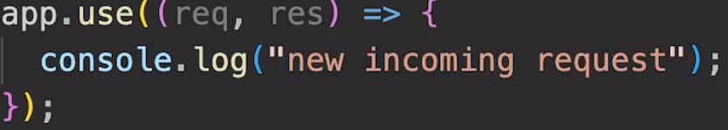
Handling request

Slide 3
SENDING A RESPONSE
Response :- Express 4.x - API Reference (expressjs.com)
Request

Slide 4
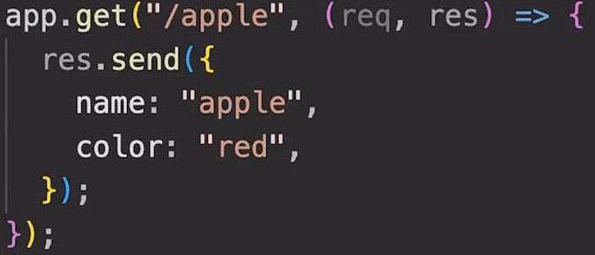
Routing
It is process of selecting a path for traffic in a network or between or across multiple networks.

Slide 5
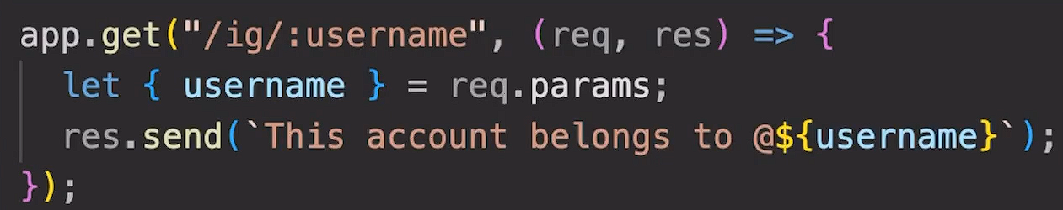
Path Parameters

Slide 6
Query String
?q=
?q=query&query

Slide 7
Templating
EJS(Embedded JavaScript templates).
EJS is a simple templating language that lets you generate HTML markup with plain JavaScript.
NPM i ejs

Slide 8
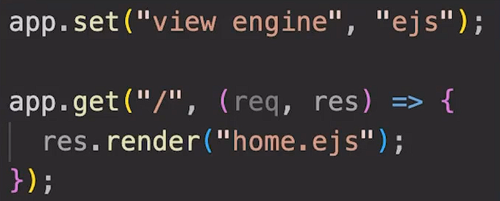
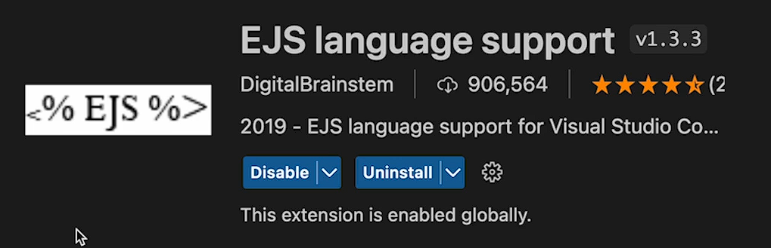
Using EJS

Slide 9
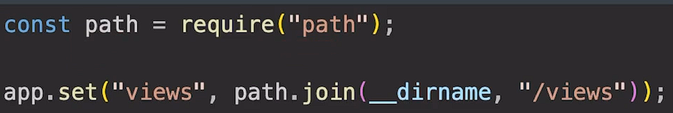
Views Directory

Slide 10
Interpolation Syntax
It refers to embedding expressions into marked up text.
EJS use kr k hum apne html ko dynamic bna skte h.
Website:- Ejs.co

Slide 11
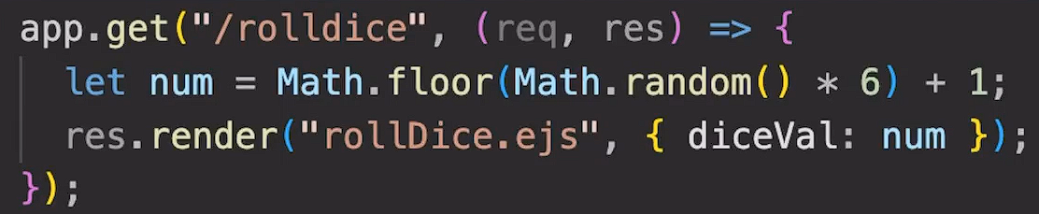
Passing data to EJS

Slide 12
Instagram EJS
Create a basic template for Instagram page based on following route:
/ig/:username

Slide 13
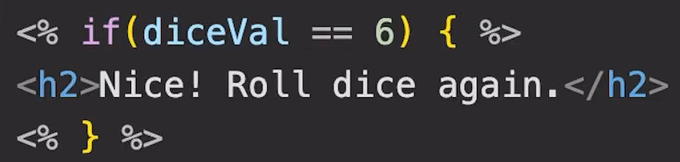
Conditional Statements in EJS

Slide 14
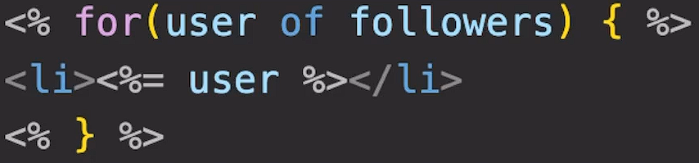
Loops in EJS

Slide 15
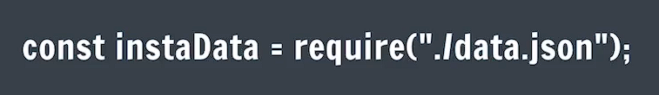
Instagram Page with EJS

Slide 16

Includes
It is a way to create sub template.

Slide 17


Slide 18
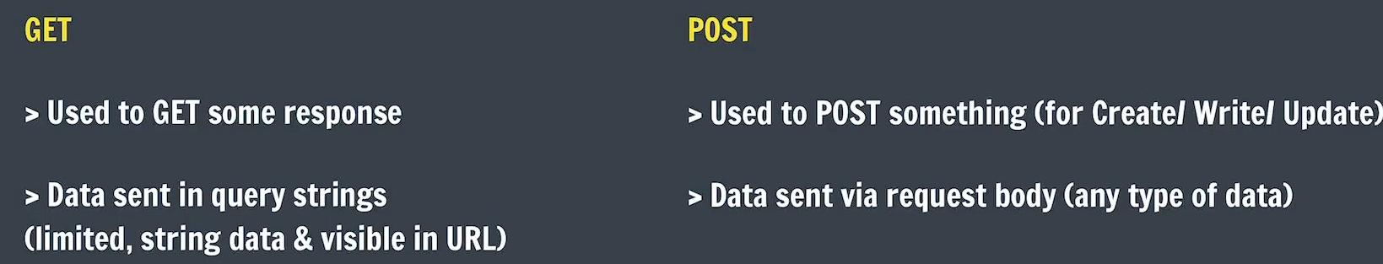
GET and POST Request

Slide 19
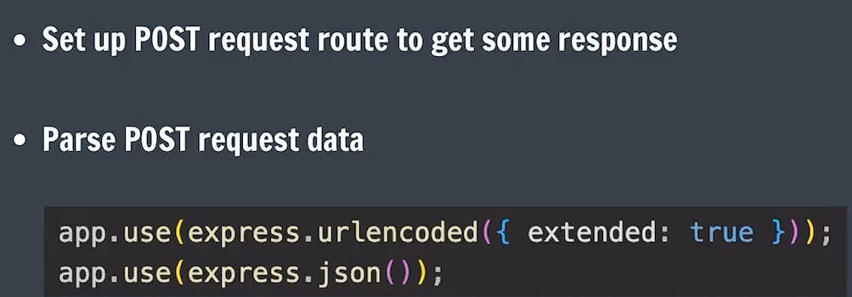
Handling POST Requests

Slide 20
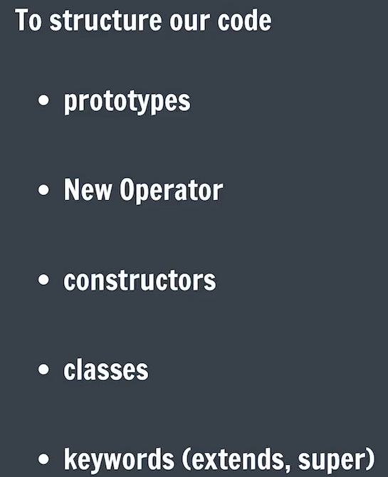
OOPS

Slide 21
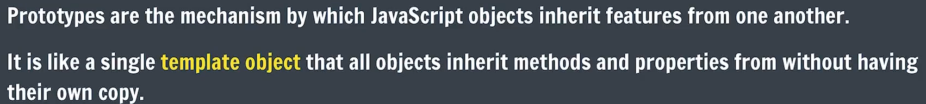
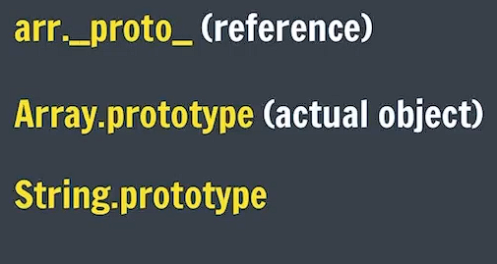
Object Prototypes

Slide 22
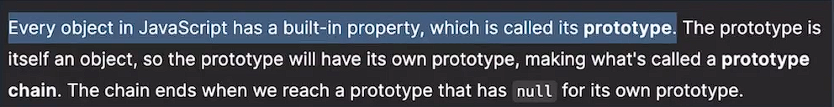
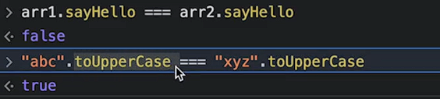
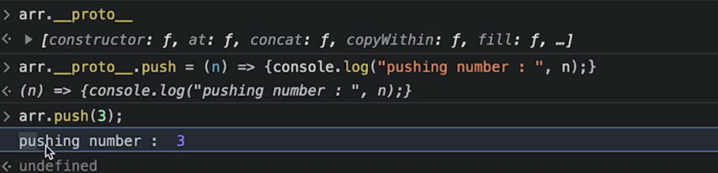

Slide 23

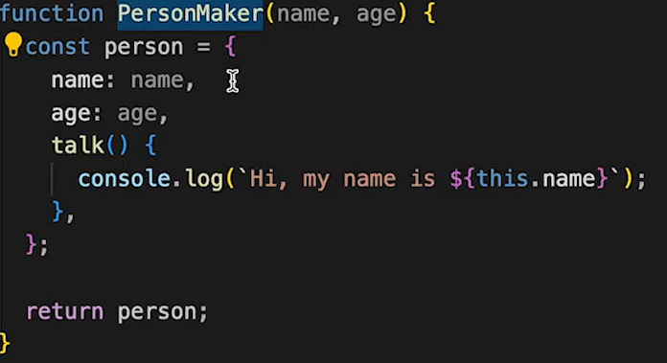
Factory Function

Slide 24
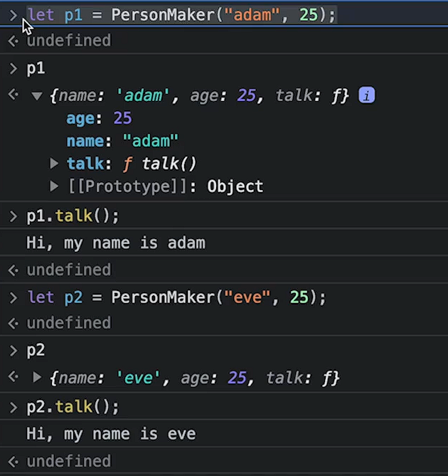

Slide 25
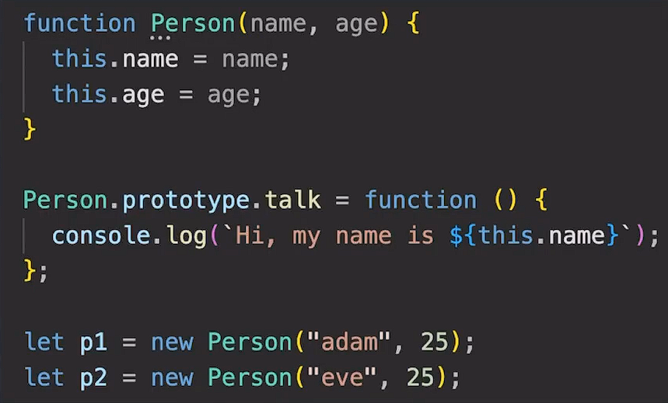
New Operator

Slide 26
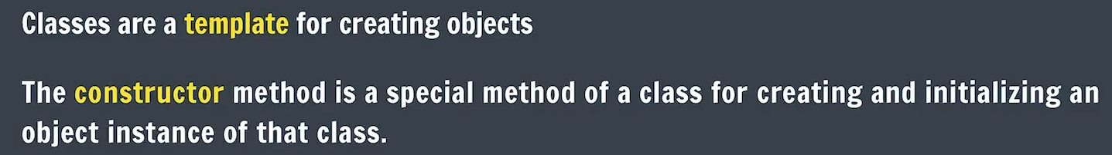
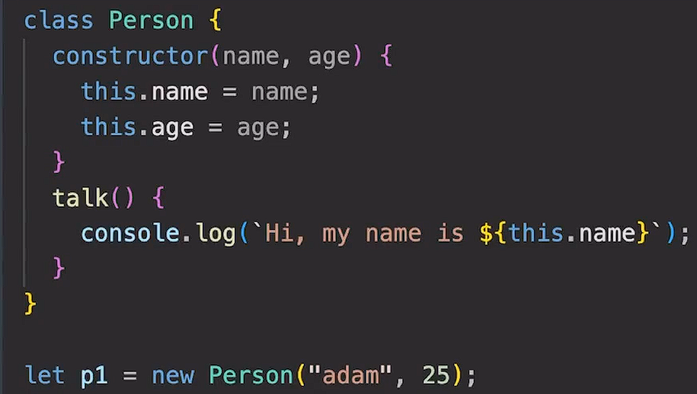
Classes

Slide 27
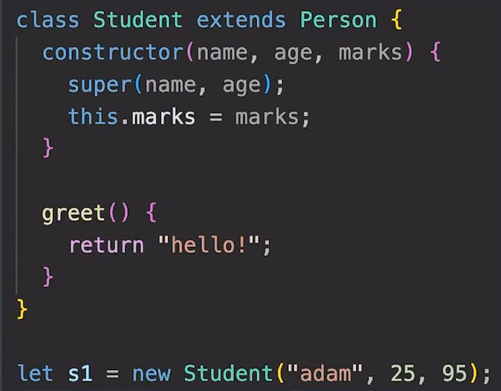
Inheritance

Slide 28
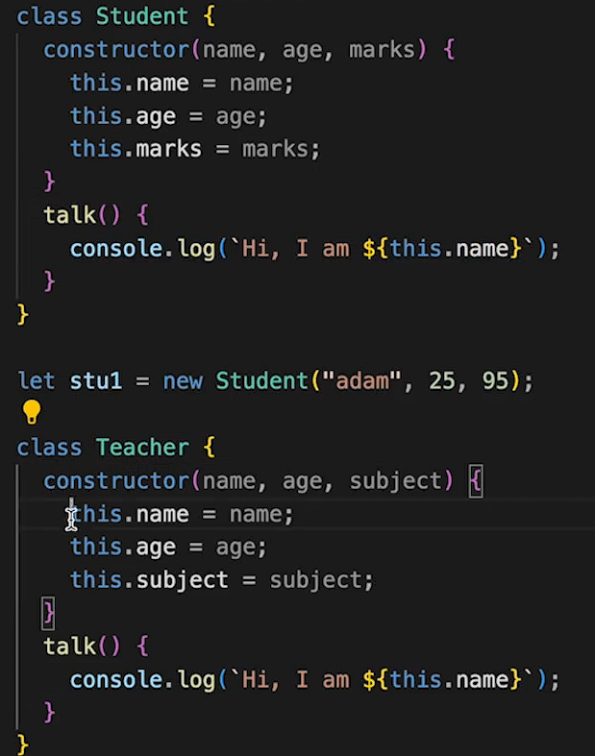
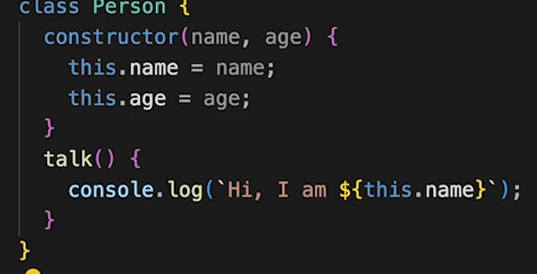
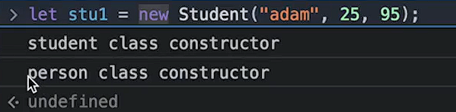

Slide 29

REST
developer.twitter.com/en/docs/api-reference-index
stackoverflow.blog/2020/03/02/best-practices-for-rest-api-design/

Slide 30
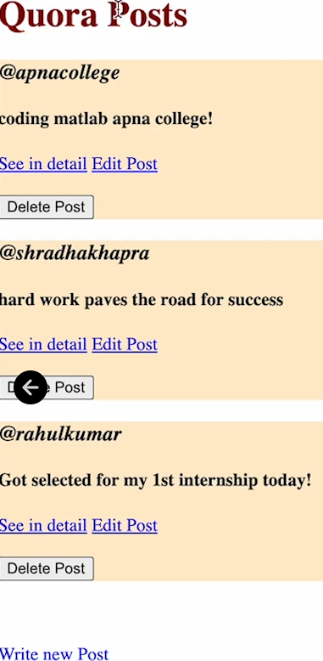
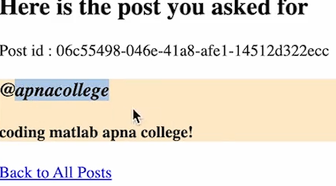
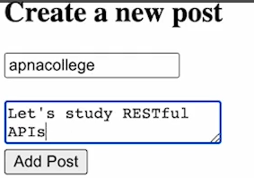
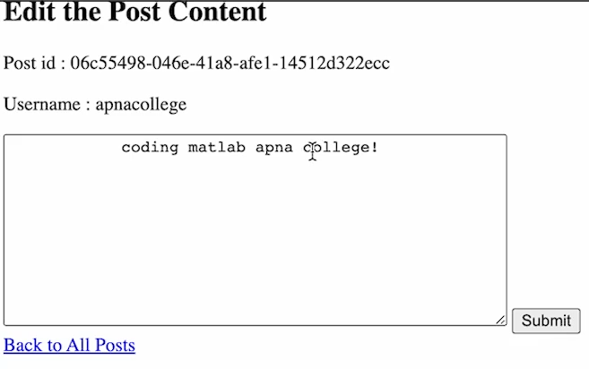

Slide 31
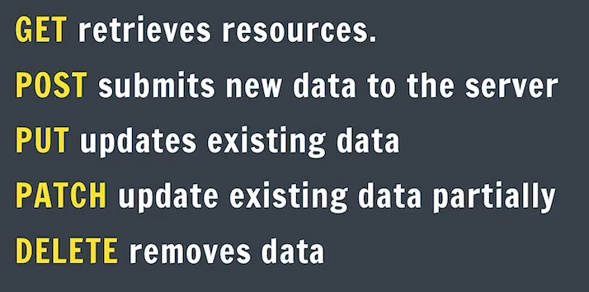
CRUD Operations

Slide 32
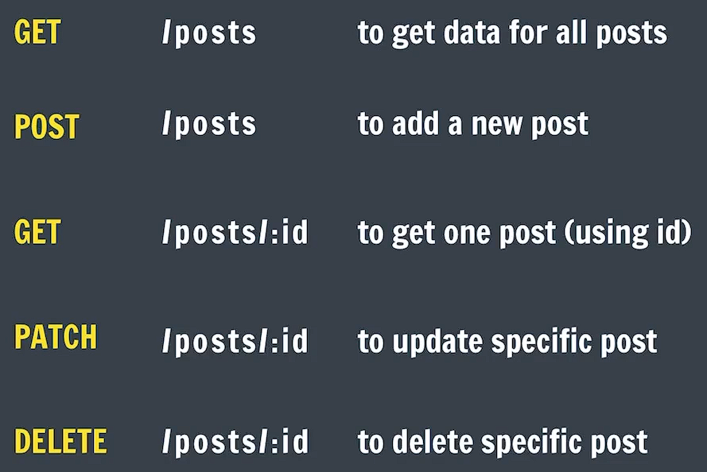
Creating RESTful APIs

Slide 33

Implement : GET/posts

Slide 34
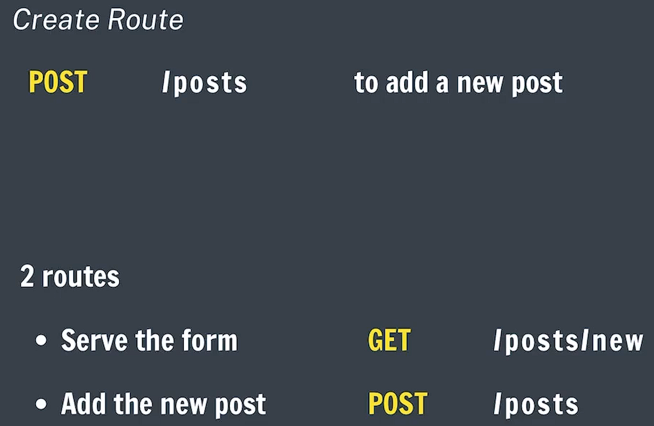
Implement : POST /posts

Slide 35

Redirect

Slide 36
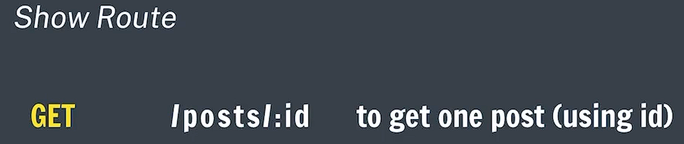
Implement : GET/posts/:id

Slide 37
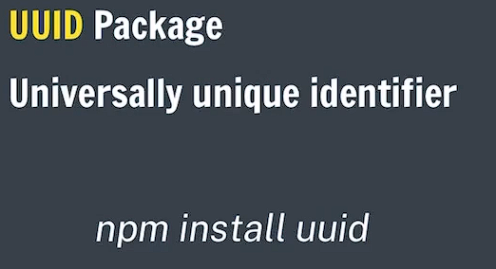
Create id for Posts

Slide 38

Implement: PATCH/posts/:id

Slide 39

Implement: /posts/:id

